Slide 1


Slide 2
Database Design
Designing a Proper Database

Slide 3
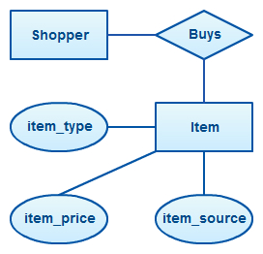
Designing A Database
We have worked with E/R diagrams
Often a good first pass at a database design
Makes your needs concrete
May expose data problems
May give you insights into what data is needed
N-to-n → Entity transformation is often valuable

Slide 4
Designing A Database
General Process
What are the core nouns in my system?
What are their relationships?
1-1
1-n
N-n (hmm)
What other nouns are needed to properly model things?
Things I haven’t thought of
Decomposing existing nouns
GOTO step 1

Slide 5
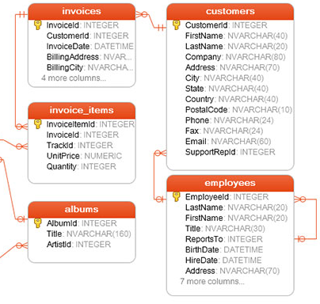
Designing A Database
Once you have an E/R diagram you can transform it into a relational schema
A relational schema typically reveals more detailed needs in your data model

Slide 6
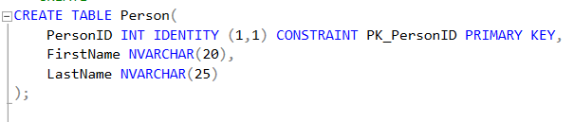
Designing A Database
Finally, this can be transformed into actual database definition statements
Yet more details and issues will come up
(we cover DDL later in the course)

Slide 7
E/R to Database Translation
Entity → Table
Relation → FK(s)
1-1 - pick the “lesser” relation to store the fk on
1-n - store the fk on the N side of the relation
N-n - Is there an entity here?
If yes, add it
If no, create a join table (a table with two FKs only)

Slide 8
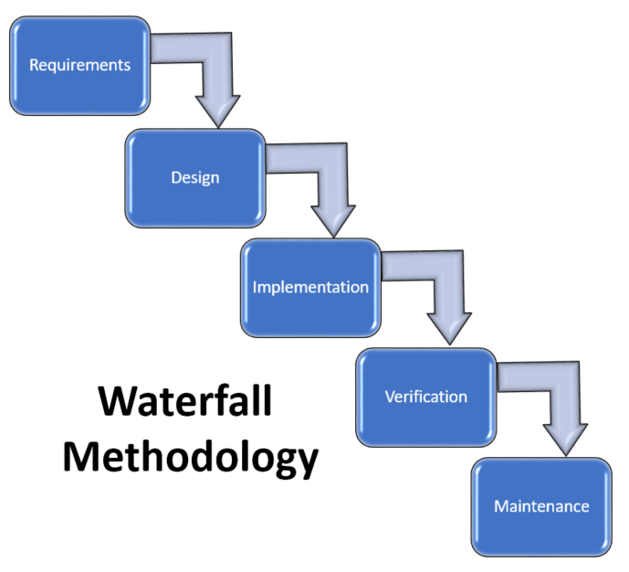
Designing A Database
How realistic is this?
E/R → Relational Schema → DDL?
Typically… not very realistic

Slide 9
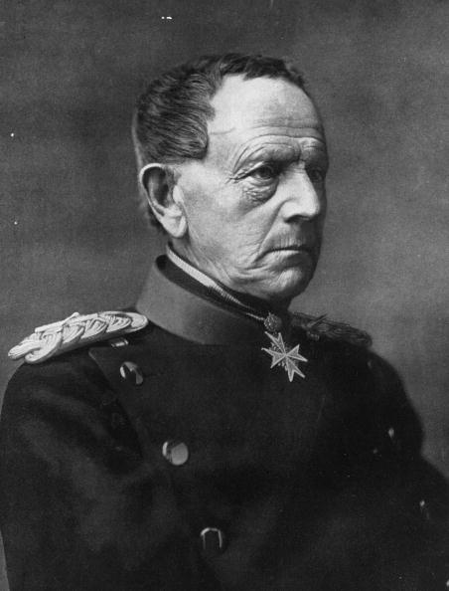
Designing A Database
"No plan survives contact with the enemy."
--Helmuth von Moltke the Elder

Slide 10
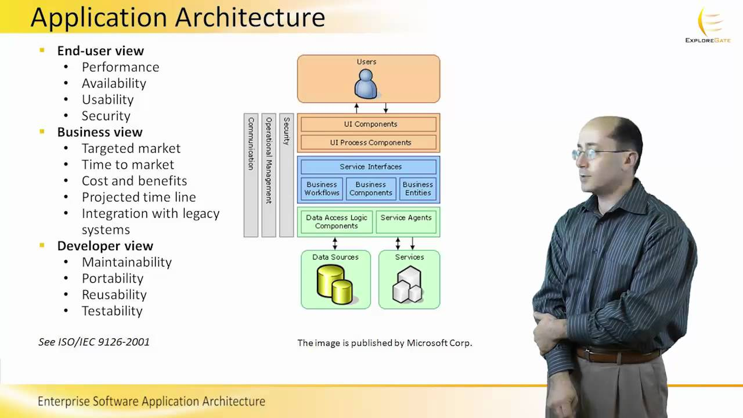
Designing A Database
As you begin working with the database schema, problems will inevitable come up
You will address them in the database directly
The E/R diagrams will become increasingly out of date

Slide 11
Designing A Database
Application architects can become increasingly irrelevant if they continue to use E/R Diagrams and other artifacts to discuss the system
They may also become increasingly annoying
Maintain a sense of humor during this process

Slide 12
Case Study - SAP
SAP is one of the most valuable software companies in the world
Worth 2 billion dollars today
Sells software to help big companies manage things like inventory
Here is a small part of their schema...

Slide 13
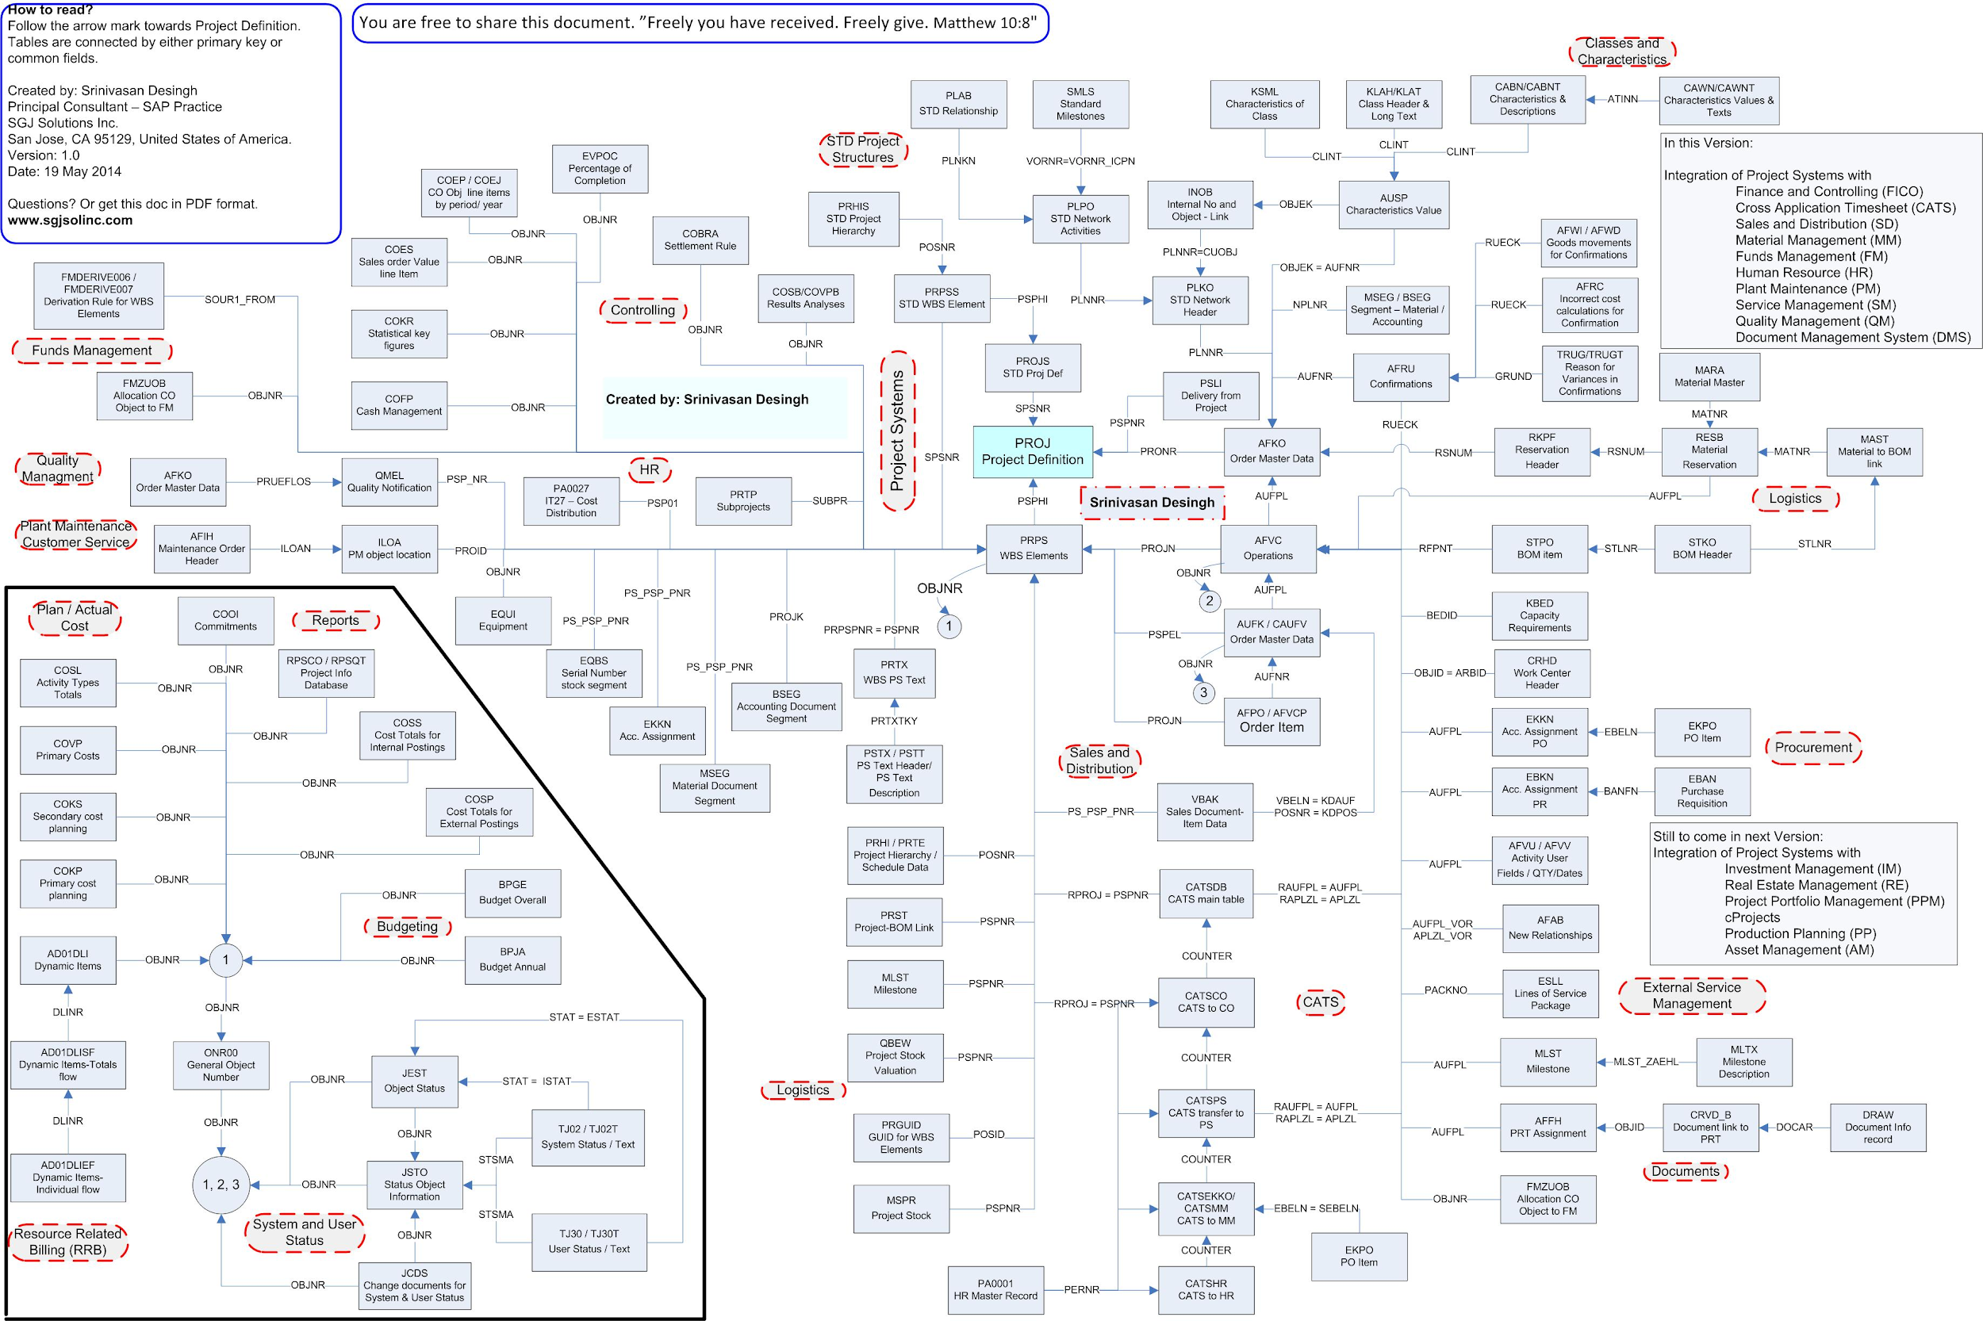
Case Study - SAP

Slide 14
Case Study - SAP
The SAP schema is famously a nightmare
It is huge
More than 8000 tables
Large parts of it make no sense
The table names are often in german
There are normalization issues all over it
We will talk about normalization in the next lecture
SAP is still worth 2 billion dollars

Slide 15
Advice On Database Modeling
As the system matures, accept that data modeling mistakes made early on are going to stick with you
The database schema get harder to fix over time
That’s OK! Learn to live with it.
QUESTION: Why is a database so much harder to fix than code?
LeadDyno DB Story Time!

Slide 16
Advice On Database Modeling
Start with E/R diagramming
But don’t take it too seriously
Get to a real world database ASAP
Iterate your app and database as quickly as possible early on when database size is relatively small
Try to figure out the crucial entities in your system and get those as right as possible
Read up on stoicism

Slide 17
Polymorphism & Databases
A Mismatch?

Slide 18
Coding With Databases
Almost all databases are fronted by some software
That software is written in a particular language
That language is probably object oriented
Java (this class)
Javascript :(
PHP XD

Slide 19
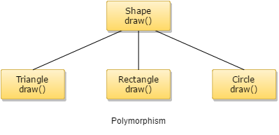
Polymorphism
You are probably familiar with this idea from your Object Oriented classes
Super-classes
Sub-classes
Sub-classes extend the super-class
Add methods and attributes

Slide 20
The Relational Model
Relations are just tables and foriegn keys
How should we model this object hierarchy if we want to store it in a table?

Slide 21
Three Approaches
Single Table Inheritance
Class Table Inheritance
Concrete Table Inheritance

Slide 22
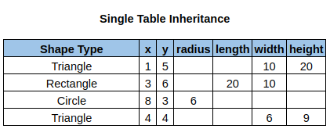
Single Table Inheritance
A single table is used for all sub-class instances
The columns are the union of all columns of sub-classes
Advantages?
Disadvantages?

Slide 23
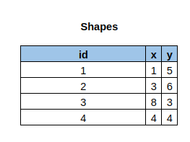
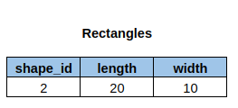
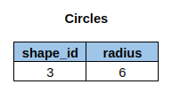
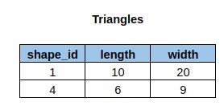
Class Table Inheritance
There is one table per class in the object hierarchy
Sub-classes include a foreign key reference to their parent classes
Advantages?
Disadvantages?

Slide 24


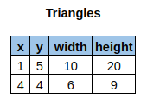
Concrete Table Inheritance
There is one table per concrete class in your object hierarchy
Advantages?
Disadvantages?

Slide 25
Polymorphism In Practice
Most systems that I have experience with use a mix:
Single Table Inheritance for closely related things with many foreign keys in common
Concrete Table Inheritance for more distant relations
I have never seen class table inheritance work out well
My advice is to focus on foreign keys: the more keys two objects have in common, the more likely you are to prefer single table inheritance

Slide 26
What Are We Dealing With Here?
This is a single instance of a more general problem...

Slide 27
The Object-Relational Impedance Mismatch
“The object-relational impedance mismatch is a set of conceptual and technical difficulties that are often encountered when a relational database management system (RDBMS) is being served by an application program (or multiple application programs) written in an object-oriented programming language or style, particularly because objects or class definitions must be mapped to database tables defined by a relational schema.”

Slide 28
The Object-Relational Impedance Mismatch
While inheritance is one issue, there are many others:
Encapsulation isn’t part of the relational model
Interfaces don’t exist at the relational level
Field accessibility isn’t specified at the relational level
Database transactions do not map well to objects
And so on
We will discuss this more thoroughly when we talk about Object/Relational mapping tools

Slide 29
The Object-Relational Impedance Mismatch
There is, however, a fundamental conceptual and cultural difference between Object Oriented and Relational thinking
Object Oriented
Imperative
Nouns + Verbs
Graphs
Relational Thinking
Declarative
Normalized
Set relationships

Slide 30


Object Databases
Some people reject the relational model entirely
OODBMS (Object-oriented database management systems) explicitly encode OO semantics
Smalltalk/GemTalk
Java/db4o
A small but passionate community

